Slide 1
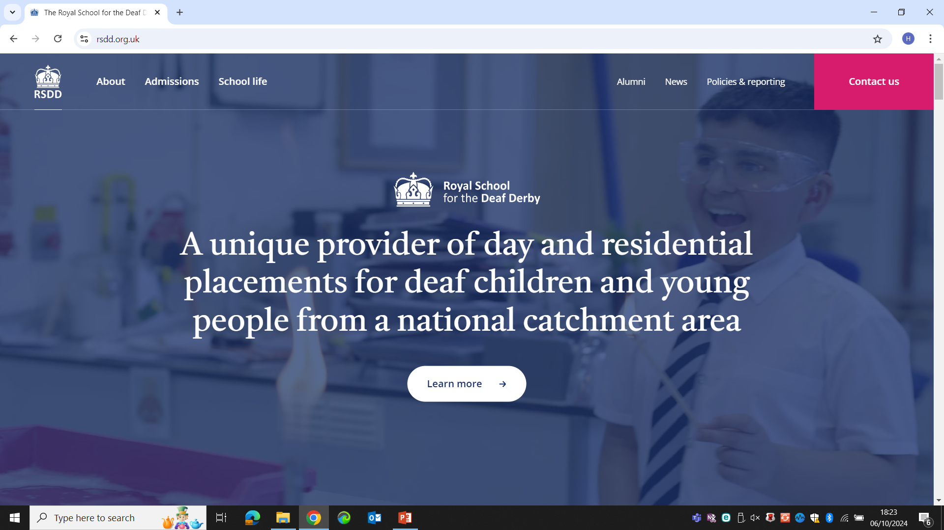
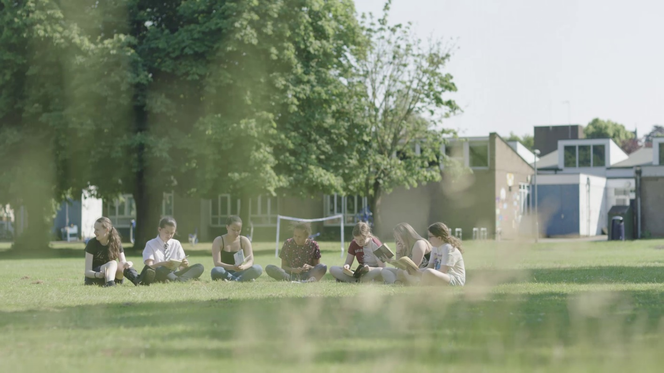
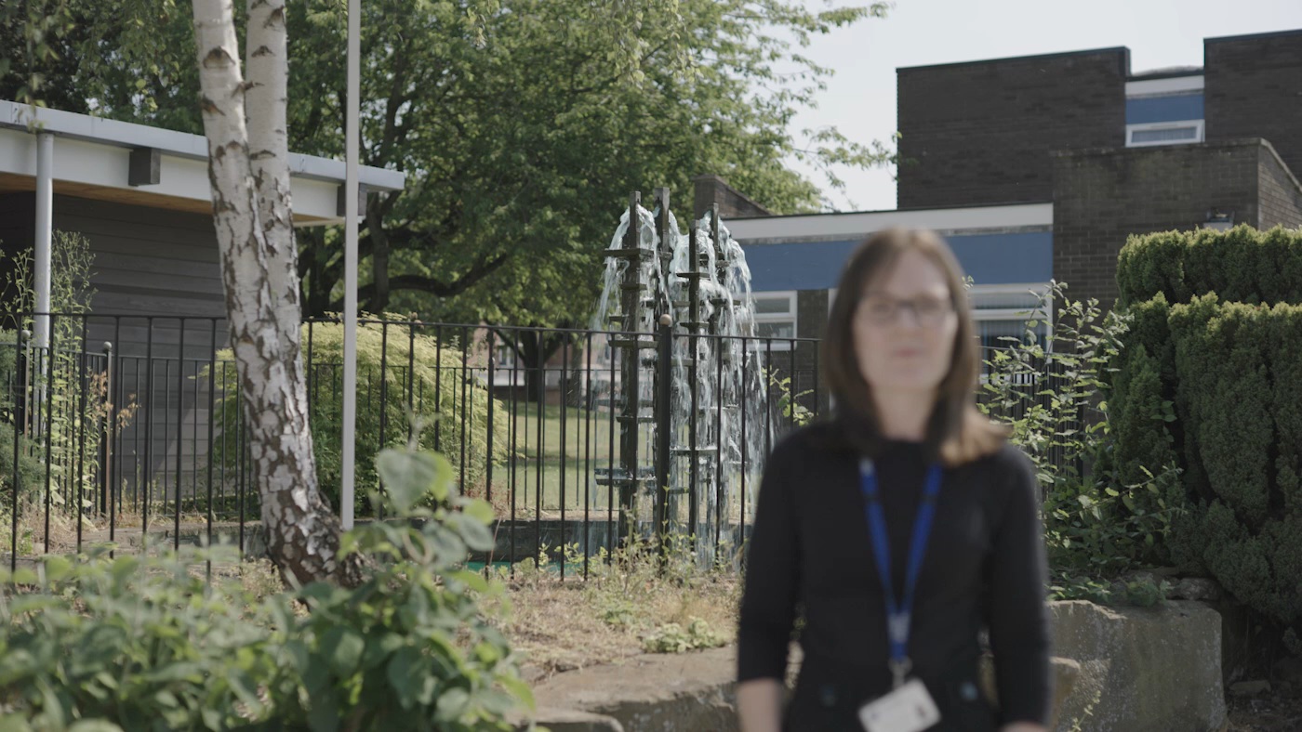
Job opportunities
Start your career here https://www.rsdd.org.uk/careers
Want an MA in Deaf Education with Qualified Teacher of the Deaf status? An advanced diploma for the Children's Workforce? A Level 4 Communication Support Worker with Deaf Learners? Accredited British Sign Language? A Level 5 Diploma in Leadership and Management for Residential Childcare? We sponsor them all.
Continuing professional development counts
With over twelve different occupational groups across the campus we have something for everyone. All staff enjoy a personalised continuing professional development plan and opportunities to gain accreditation in their roles. A real commitment to work life balance and generous terms and conditions make for a confident, qualified and competent staff team driving our successes.
Application Brochure

Slide 2
Contents
1. Our School
2. Pay and accountabilities
3. The Person
4. How to apply
5. Selection & Assessment | Dates
Notes:
Alter as applicable

Slide 3
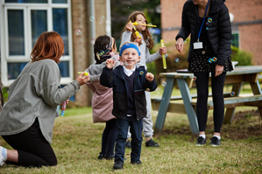


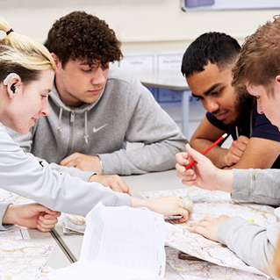
Our School

Slide 4
Pay & Accountabilities
£24,027 - £30,060 pa depending on qualifications and experience

Slide 5
The Person
Qualifications | Essential | Desirable
Level 3 Certificate in Communication Support for Deaf Learners (or willing to train towards as soon as practicable after appointment) | •
Modifying written English texts for Deaf people |  | •
A good level of general education across a range of curricula including Mathematics, English and IT | •
British Sign Language Level 2 or proficient signer | •
British Sign Language Level 3 (or willing to train towards as soon as practicable after appointment) |  | •
GCSE English grade 4 – 9 (C –A*) or equivalent | •
Experience | Essential | Desirable
Supporting and communicating for learners in an educational setting | •
Contributing to Individual Learning Plans and helping to track learner progress |  | •
Using a range of strategies to resolve potentially challenging behaviours | •
Putting SEND legislation into practice for the benefit of children and young people | •
Knowledge | Essential | Desirable
A range of positive strategies and interventions to support the progress of learners | •
The effects of specific types of communicative behaviour, e.g. proximity, tone and gesture, and non-verbal behaviour, e.g. body language, personal space, on pupils’ emotional and behavioural responses, and how positive examples of these can improve pupils’ self-esteem and social response |  | •
Deaf Community and context |  | •
The rights of the children and young people including the right to be treated with dignity and respect | •
Skills | Essential | Desirable
Able to build positive and constructive relationships with children and young people | •
Able to work autonomously and on a one: one basis | •
Proficient communication in both British Sign Language and English | •
Ability to work in a non-judgemental and confidential manner | •
Able to use strategies for rebuilding damaged emotional relationships between pupils and their peers | •
Ability to promote good team working, support colleagues and remain professional at all times | •
Ability to create and maintain a positive learning environment where young people feel safe, happy and engage in teaching and learning | •
The ability to reflect on own behaviour for example, the importance of modelling the behaviour you want to see and the implications of this for your own behaviour | •
Other | Essential | Desirable
The health and physical capacity to provide continuity of support for teaching and learning as set out in The Education (Health Standards) (England) Regulations 2003 | •
Appropriate assertiveness and negotiation skills for working with young people | •
Emotionally resilient, able to remain calm when faced with sensitive/emotional matters and when working under pressure | •
Motivated to take responsibility for own continuing professional development (CPD) and participate in whole school and departmental CPD sessions | •

Slide 6





How to apply
Find out what we have been up to on our Facebook pages at www.facebook.com/RSDDOfficial and/or why not come and see for yourself? Contact us on 07500 878565 (Voice/SMS/ BSL WhatsApp) to visit in person or book an informal chat about the role
Visit our careers pages here or at, https://www.rsdd.org.uk/careers
Download, complete and send your application form to Kristy.Orpwood@rsdd.org.uk
If you are shortlisted for a role you will also need to complete the Self Declaration
Closing Date: 15 April 2025 Interviews: 24 April 2025

