Slide 1
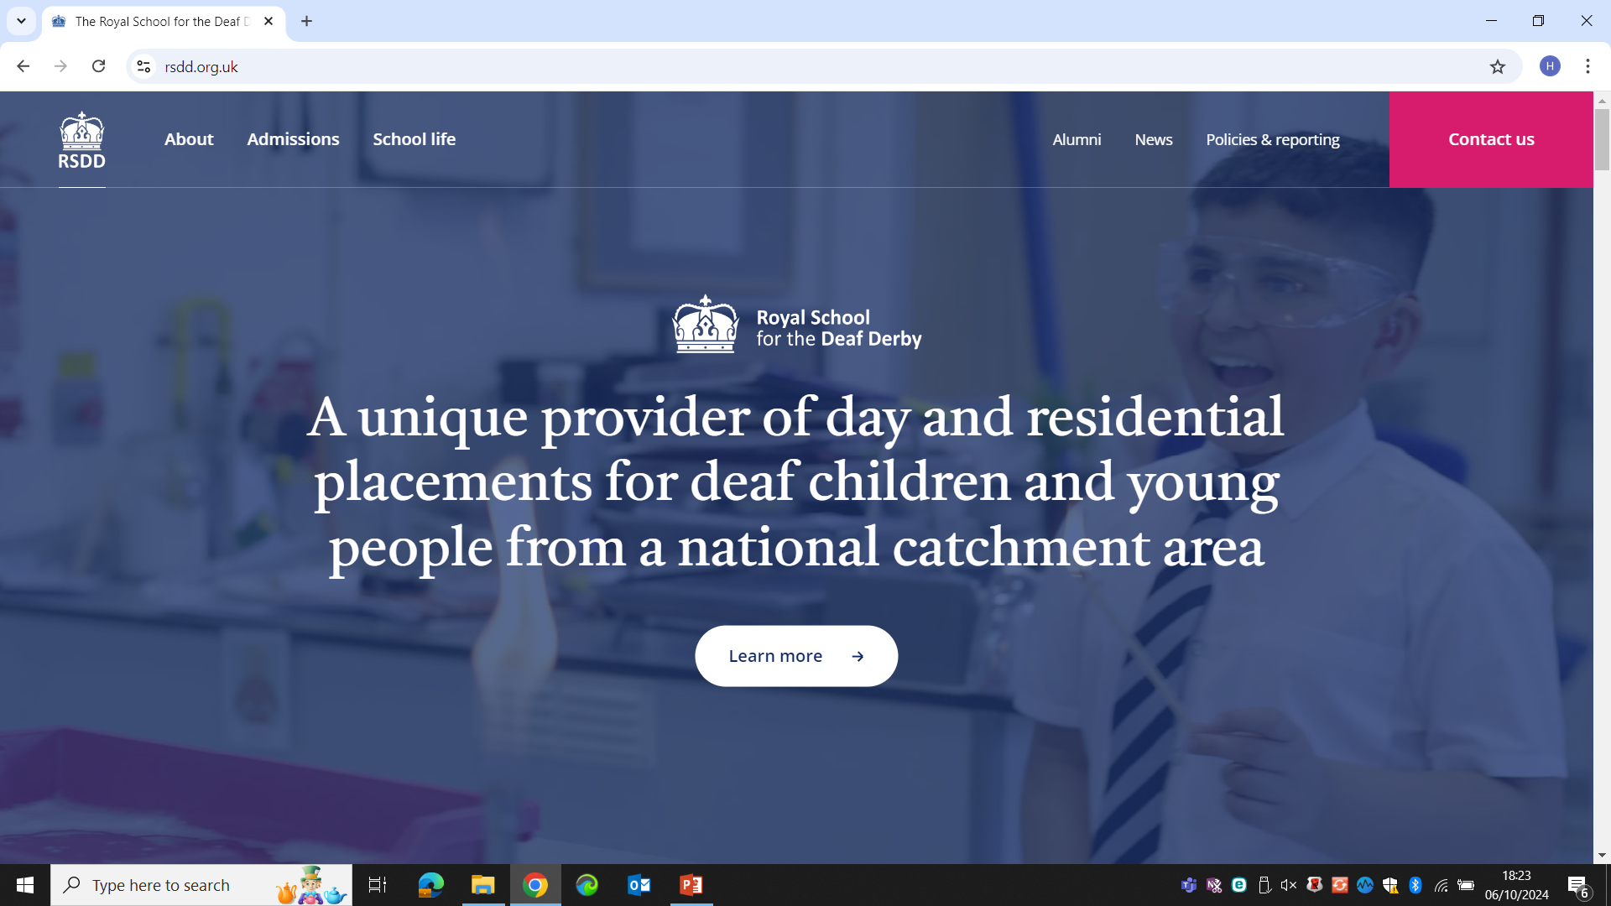

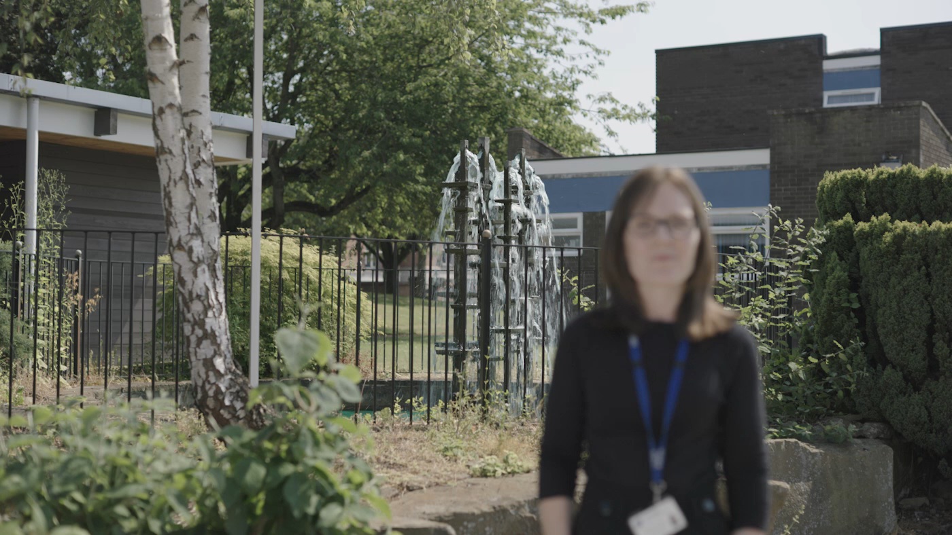
Job opportunities
Start your career here https://www.rsdd.org.uk/careers
Want an MA in Deaf Education with Qualified Teacher of the Deaf status? An advanced diploma for the Children's Workforce? A Level 4 Communication Support Worker with Deaf Learners? Accredited British Sign Language? A Level 5 Diploma in Leadership and Management for Residential Childcare? We sponsor them all.
Continuing professional development counts
With over twelve different occupational groups across the campus we have something for everyone. All staff enjoy a personalised continuing professional development plan and opportunities to gain accreditation in their roles. A real commitment to work life balance and generous terms and conditions make for a confident, qualified and competent staff team driving our successes.
Application Brochure
Notes:
Please keep the branding as Tapton School Academy Trust.

Slide 2
Contents
1. Our School
2. Pay and accountabilities
3. The Person
4. How to apply
5. Selection & Assessment | Dates
Notes:
Alter as applicable

Slide 3

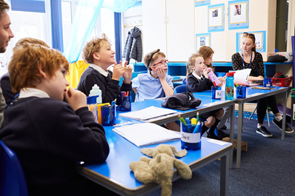

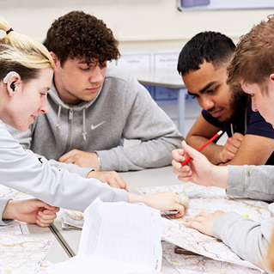
Our School

Slide 4
Pay & Accountabilities
Title of Role
Wellbeing Team Leader/ Deputy Designated Safeguarding Lead
Line Management
Responsible to: Deputy Headteacher and Designated Safeguarding Lead
Summary Terms and Conditions
£28,770 - £33,945 gross pa actual. There is a pay award pending which will take this salary to £30,060 - £35,235 gross pa actual. 37 hours a week Monday – Friday, term time only (195 working days per academic year)
Key Purpose
To champion and support the mental health, wellbeing of children and young people through facilitating a safe, calm and supportive learning environments
To be the Deputy Designated Safeguarding Lead
To encourage positive behaviour choices by supporting PROACT- SCIP techniques within the team
To develop and oversee interventions that improve not only mental health and wellbeing but more broadly improved attainment, attendance and resilient children and young people and to keep abreast of best practice by understanding and implementing government guidance and initiatives
To support improving attendance across the school in consultation with SLT and develop attendance strategies in accordance with best practise and government guidance
Supervisory Responsibilities
Responsible to: Deputy Headteacher (Designated Safeguarding Lead)
Responsible for: Wellbeing Champions
Functional Relationships
Deputy Headteacher/ Designated Safeguarding Lead/ Senior Mental Health Lead
Senior Leadership Team
Wellbeing Champions
Wellbeing Team
Special Educational Needs Coordinator
Main Duties and Accountabilities
To develop, implement, monitor and evaluate the school’s strategic plan and interventions to improve the mental health and wellbeing across school to include the key principles below.
Curriculum teaching and learning to promote resilience and support social and emotional learning
Enabling the experiences and views of deaf children and young people to influence decisions
Staff development to support their own wellbeing and that of students
Identifying need and monitoring impact of interventions
Working with parents and carers
Targeted support and appropriate referral
An ethos and environment that promotes respect and values diversity
Liaise with key staff to discuss concerns regarding children and young people students whose mental health and wellbeing falls below expectations to identify, implement and monitor targeted interventions
To be the first point of contact for external agencies supporting the mental health and wellbeing of children and young people including Deaf CAMHS
Work closely with the school administration, safeguarding and teaching teams to understand and address the needs of absent children and young people to ensure they attend on a consistent basis
To respond to requests from external partners for example, Local Authorities for absence data
To produce regular reports on safeguarding, mental health, wellbeing, attendance and behaviour supported by robust data to evidence progress
To meet with children and young people and their parents/carers to identify issues and concerns and put in place an appropriate plan to support children and young people to improve their mental and physical health, wellbeing, attendance and/or behaviour
To ensure effective communication between all staff regarding identified pupils and between school and home.

Slide 5
Pay & Accountabilities
To develop effective 1:1 relationships with pupils and young people to enable positive rapport and the monitoring of progress towards agreed goals; work with individual and small groups of children and young people to deliver interventions
To document progress against the starting points of children and young people’s mental health, wellbeing, attendance and behaviour capturing improvements over time and intervening if progress in these areas is not convincing
To be an active member of the safeguarding team and respond to concerns raised by staff passing on any complex concerns to the Designated Safeguarding Lead; to deputise for the Designated Safeguarding Lead
To take a lead role in the monitoring and evaluation of pupils’ personal development, welfare, behaviour and attendance and the quality of care and guidance over time leading to robust school improvement planning for safeguarding, wellbeing, behaviour and attendance
To participate in annual review and behaviour monitoring processes including attending review meetings, contributing to reports, Education and Health Care Plans, risk assessments, behaviour management plans, care plans and intervention plans
To attend safeguarding meetings for example, Children in Need, case reviews, serious case reviews, Team Around the Child and strategy meetings
To promote the participation of staff (including self) in relevant continuing professional development
To support good order and discipline amongst pupils and staff through the support and maintenance of a positive welfare and learning culture in residences and throughout the school
To promote harmonious working relationships within the school including having proper regard for a work life balance for staff within legitimate expectations of their accountabilities
To maintain positive relationships with external organisations where the school benefits from contact and networking. To collaborate and work with colleagues and other relevant professionals within and beyond the school including Local Authorities and the Derby Derbyshire Safeguarding Children’s Partnership
To remain up to date with all local and national developments, relevant guidance and legislation and to advise colleagues appropriately
To support the Headteacher according to the emerging needs of the school within the context of a reasonable balance between accountabilities and outside life

Slide 6
The Person
Education/training/qualifications | Essential/Desirable | Measured by:
Qualified Teacher Status | D | A/C
Qualified Teacher of the Deaf | D | A/C
Qualified Social Worker | D | A/C
Appropriate underpinning L5 Qualification for the Childrens’ Workforce | D | A/C
British Sign Language Level 3 or native/pre lingual British Sign Language User | E | A/C
Evidence of regular and appropriate professional development | E | A/I
Qualified PROACT-SCIPr-UK® Instructor or willing to train towards this as soon as practicable after appointment | D | A/I/C
Experience & Skills | Essential/Desirable | Measured by:
Significant recent and relevant experience of leading a team and raising standards | E | A/R
Experience of working effectively at a middle or senior leadership level in a Special School | D | A/I/R
Analysing data including tracking pupil behaviour data, identifying trends, evidencing school performance and improvement, target setting | E | A/I/R
The ability to investigate, solve problems, make and implement decisions | E | A/I/R
External Inspection regimes including Ofsted Education and Ofsted Welfare | E | A/I/R
Experience of attending safeguarding meetings such as CIN, TAC, serious case and strategy meetings | D | A/I
Annual Review processes, planning and transition arrangements | D | A
Excellent people management skills and competencies as set out in the School competency framework for people managers | E | A/I/R
Knowledge & Understanding Up to date knowledge and understanding of current and best practice including: | Essential/Desirable | Measured by:
Child protection and health and safety issues | E | A/I
Knowledge of best practice in managing the behaviour of children and young people with complex special educational needs | E | A/I
Strategies for raising pupils’ well being and achievement (socially, emotionally and educationally) | E | A/I/R
Strategic planning linked to school improvement including attendance and behaviour for learning | E | A/I/R
Deaf Community and Context, educational provision for deaf children and young people | D | A/I
Current SEND legislation | E | A/I
Personal qualities | Essential/Desirable | Measured by:
Dedicated to the safeguarding and welfare of children and young people | E | A/I/R
Personal drive, enthusiasm and commitment to securing the best possible learning outcomes for every pupil | E | A/I/R
An open, transparent, collaborative approach to managing people and other resources | E | A/I
Fluent communication skills, the ability to persuade and influence others | E | A/I
Evidence of being able to build and maintain constructive relationships with children and young people, staff, parents and carers and the wider community | E | A/I
A good record of health, attendance and timekeeping | E | A/I/R
Able to argue ones case rationally | E | A/I
Able to manage own work-life balance and that of others | E | A/I
Physical and Mental Health | Essential/Desirable | Measured by:
The ability to perform all duties and tasks with reasonable adjustment, where appropriate, in accordance with the Equality Act 2010 | E | A/R
Own physical and mental health does not constitute any risk to the health, safety or well-being of children or jeopardise the continuity of support the role provides to them | E | A/R

Slide 7


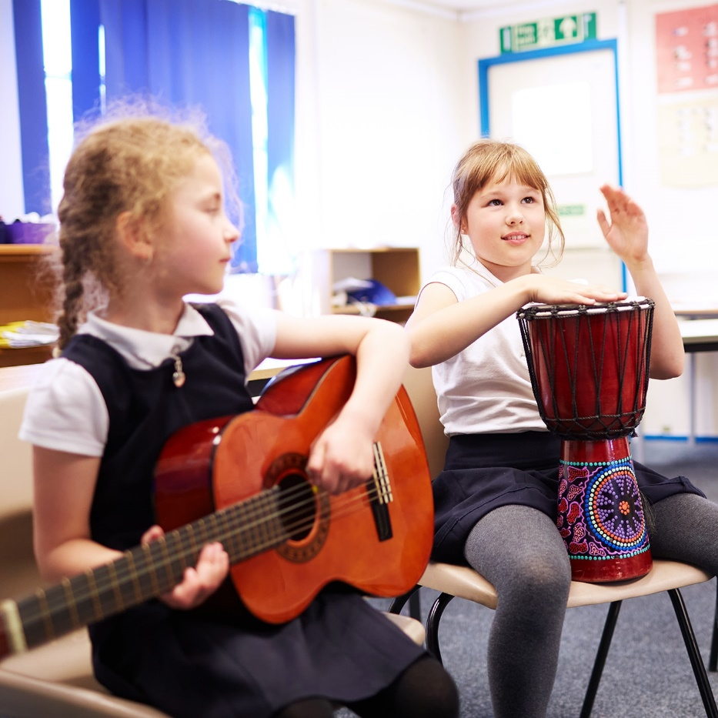


How to apply
Find out what we have been up to on our Facebook pages at www.facebook.com/RSDDOfficial and/or why not come and see for yourself? Contact us on 07500 878565 (Voice/SMS/ BSL WhatsApp) to visit in person or book an informal chat about the role
Visit our careers pages here or at, https://www.rsdd.org.uk/careers
Download, complete and send your application form to alex.jones@rsdd.org.uk
If you are shortlisted for a role you will also need to complete the Self Declaration
Closing Date: 05 November 2024 Interviews: Tuesday 12 November 2024

